Slide 1
CRIS GOLD™
Autonomic Regulation Index (ARI)
Clinical Interpretation Framework for Autonomic Nervous System Balance
HeartQuest Professional Integration

Slide 2
CRIS Autonomic Nervous System Regulation Index (ARI)

Slide 3

What is ARI?
ARI = Autonomic Regulation Index
  Composite score describing how well the Autonomic Nervous System is balanced and adaptive
  Derived from HeartQuest Professional HRV metrics
  Used inside CRIS GOLD for quadrant placement and treatment logic
Notes:
Can handle the demands of life it you have a robust ANS

Slide 4

Why ARI Matters Clinically
ANS dysregulation is linked to fatigue, anxiety, chronic illness, pain, and cognitive decline
  ARI summarizes complex HRV patterns into a clinically usable signal
  Allows fast protocol selection and tracking over time

Slide 5

HQP Parameters Used in ARI
SDNN – overall autonomic adaptability
  RMSSD – parasympathetic (vagal) function
  Stress Index – sympathetic load
  LF% – sympathetic/baroreflex activity
  HF% – parasympathetic activity
  VLF% – central nervous system & emotional load
  Total Power – energetic reserve

Slide 6


Conceptual Model
High ARI = flexible, resilient nervous system
  Low ARI = rigid, overloaded, or depleted nervous system
  Balanced sympathetic + parasympathetic activity = optimal regulation

Slide 7
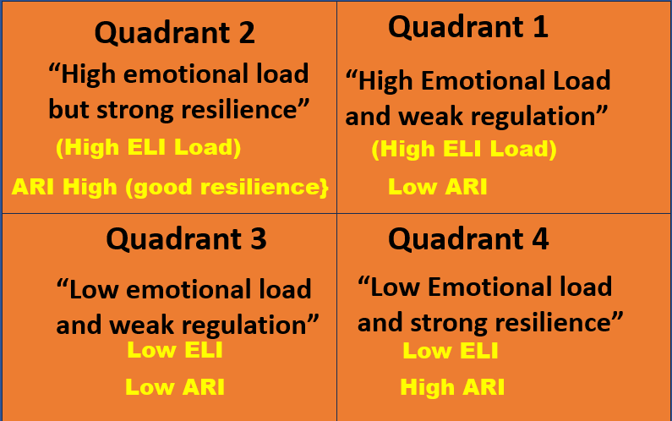
ARI and CRIS GOLD Quadrants
Q1 – Low regulation + low energy (depletion)
  Q2 – Low regulation + high stress (overdrive)
  Q3 – Improving regulation (recovery)
  Q4 – High regulation + high resilience (optimal)

Slide 8
ARI Clinical Interpretation
Low ARI patterns:
  • Low SDNN + low Total Power
  • High Stress Index
  • High LF% with low HF%
  • High VLF% emotional load
  High ARI patterns:
  • Normal/high SDNN
  • Balanced LF/HF ratio
  • Normal Stress Index
  • Adequate Total Power

Slide 9
ARI Integration in CRIS GOLD
Automatically calculated after HQP data entry
  Used to drive:
  • Quadrant selection
  • NeuroVIZR protocol mapping
  • Supplement category prioritization
  • ERM / ELI contextual weighting

Slide 10
ARI + NeuroVIZR Mapping
Low ARI → autonomic stabilization protocols
  Stress dominant → calming + vagal activation programs
  Depletion dominant → gentle activation + energy restoration
  High ARI → performance optimization protocols

Slide 11
ARI Use Cases
Chronic fatigue & burnout
  PTSD / anxiety
  Long COVID
  Cardiometabolic dysfunction
  Neurocognitive decline
  Athletic overtraining

Slide 12
Tracking ARI Over Time
Baseline ARI at intake
  Re-test after interventions
  Trend analysis shows autonomic recovery or deterioration
  Objective marker for treatment effectiveness

Slide 13
Summary
ARI simplifies autonomic complexity into a clinically actionable index
  Built directly from HQP physiology
  Core driver of CRIS GOLD intelligence
  Enables consistent, scalable clinical decision-making

